Slide 1
Assignment#1
Student Course Registration System

Slide 2
Submitted By:
Abdullah SP20-BSE-006
Sameer Rehman SP20-BSE-050
Hafiz Azam Dilawar SP20-BSE-110
Submitted To:
Dr. Fatima Sabir

Slide 3
TO DO
Design the Sprint based on the functional requirement available in the project documentation. Use any tool like JIRA and integrate the requirement with Project code available on GitHub. Design at least three sprints( more than 3 if possible?) for each project and distribute different roles among team members. The guidelines are as follows,
Project Starting date should be January 15,2023 and Ending date will be May 07,2023.
Three sprints must be designed now up to March 05,2023. Each sprint duration is not more than 2 weeks or 10 working days, and has working hours not more than 7 per day.
Integrate these tasks and attach with the code available on GitHub.
Use any open source code checker available on GitHub to attach with the GitHub repository.
Design the project introduction page based on the information available in the documentation and should be available over the GitHub.
Prepare the Project Report and Presentation of the Assignment 1.

Slide 4
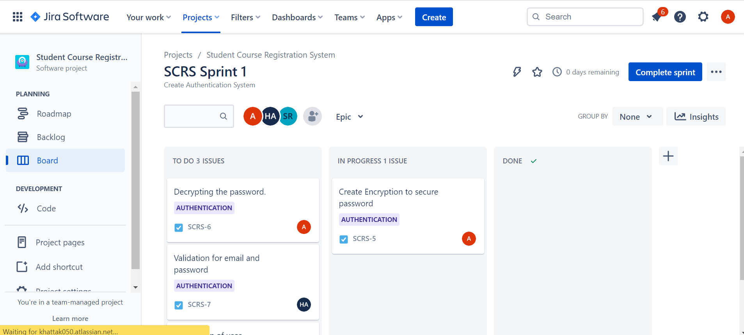
JIRA Sprints

Slide 5
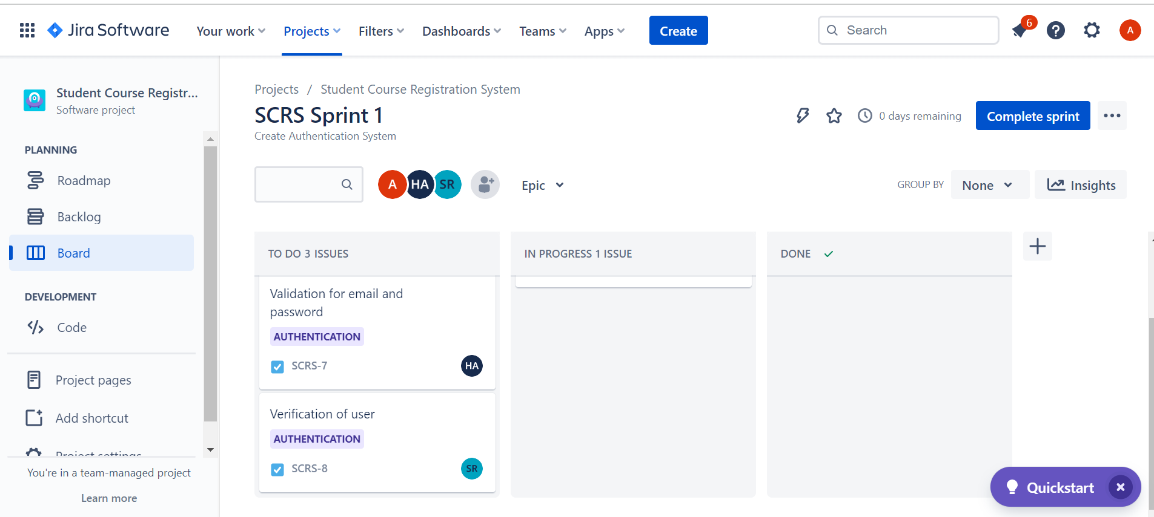
Jira

Slide 6
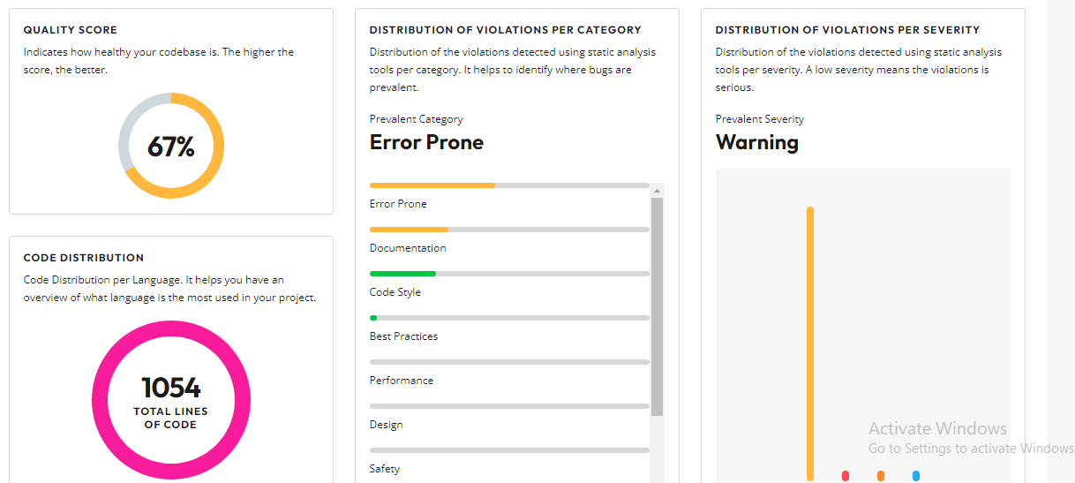
CODE EFFICIENCY WE USE CODIGA

Slide 7
GITHUB REPOSITORY
Following is the link to our repository:
https://github.com/Hafiz-Azam/TSE-1
Further information is added in the readme file.

Slide 8
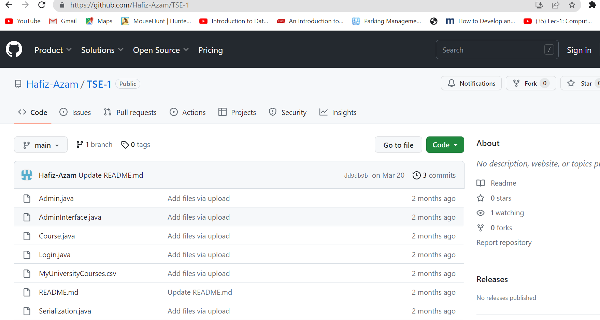
Git hub

Slide 9
THE END

